Slide 1
Optimization of Green-Times at an Isolated Urban Crossroads
M. Ebrahim Fouladvand and Masoud Nematollahi
The European Physical Journal B, Vol. 22 pp. 395-401 (2001)
Presenter： Shiuan-Wen Chen
Date： Sep. 21, 2006

Slide 2
ABSTRACT
We propose a model for the intersection of two urban streets. The traffic status of the crossroads is controlled by a set of traffic lights which periodically switch to red and green with a total period of T. Two different types of crossroads are discussed. The first one describes the intersection of two one-way streets, while the second type models the intersection of a two-way street with an one-way street. We assume that the vehicles approach the crossroads with constant rates in time which are taken as the model parameters. We optimize the traffic flow at the crossroads by minimizing the total waiting time of the vehicles per cycle of the traffic light. This leads to the determination of the optimum green-time allocated to each phase.

Slide 3
I. INTRODUCTION
The first model introduced by statistical physicists for the description of the city network, known as the BML model in the literature, uses a deterministic cellular automata framework.
Later, a more serious model of city network was introduced by Chowdhury and Schadschneider (CS model) [20] which developed a more detailed fine-grained description of city traffic.
Knowing the local optimum behaviour of single intersections could give us an appropriate criterion to control the set of crossroads in an adaptive manner.

Slide 4
I. INTRODUCTION
Additionally, not all the intersections of a city are highly affected by the neighbouring intersections.
To a good approximation, marginal intersections could be regarded as isolated crossroads and therefore single-crossroads optimization strategies need to be investigated.
In this paper we aim to analyze a single crossroads in detail in order to find a better insight to the problem of optimizing the total flow in cities.

Slide 5
II. One-Way to One-Way Crossroads
N
α₁ , α₂ : arrival rates of the cars(the number of cars reaching the crossroads per second)
β₁ , β₂ : passing-rate of cars(number of cars passing the crossroads in
the unit of time during the green-phase)
Cycle: T
Begin: S-N green
0 ~ T₁ ~ T
β₁
α₂
β₂
W
E
g
g
α₁
S

Slide 6
II. One-Way to One-Way Crossroads
Now the basic question is ” how should traffic engineers adjust the value of T₁ in order to optimize the traffic flow through the intersection?”.
The optimization task is realized by minimizing the total waiting time of the cars per cycle of the traffic light.
N₁ , N₂ : represent the number of cars stopping (queues) at the red lights in the red phases of the S-N and W-E streets respectively.

Slide 7
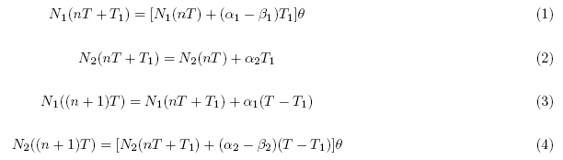
II. One-Way to One-Way Crossroads
The dynamics of N₁ and N₂ are read from the following equations in which n denotes the cycle number of the traffic light:
The Θ symbols ensure the positiveness of the quantities in the brackets,

Slide 8
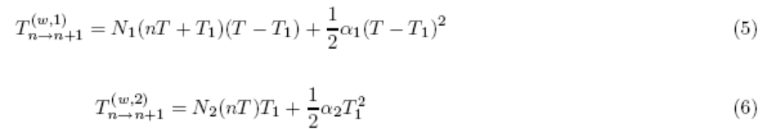
II. One-Way to One-Way Crossroads
TWT : total waiting time of the vehicles per cycle of the traffic light. It is the total time wasted by the vehicles during their stop in the red phases.
The TWT is the sum of the sub-waiting times of each direction.
Denoting the TWT and the sub waiting times by T^{w},
T^{(w,1)} and T^{(w,2)} respectively, the following equations could be written for the n-th cycle.

Slide 9

II. One-Way to One-Way Crossroads
The second part is related to the contribution given by the new oncoming vehicles arriving at the S-N direction of the crossroads during the red period which lasts for T − T₁ seconds.
The analytical expression of the TWT strongly depends on the positiveness of the queues’ lengths just after the lights go red.
we show that different traffic status can be identified according
to the behaviour of the quantities N₁(nT + T₁) and N₂(nT ).

Slide 10
II. One-Way to One-Way Crossroads
n = 0. If N₂(0) = 0(a complete passing of the previous W-E queue) then it is easily seen that in order to have a complete passing of the next W-E queue, one should have the condition α₂ T − β₂(T − T₁) ≦ 0.
It can be easily verified that that provided that the above stability condition holds, we have no W-E queues after the W-E light goes red for the general n-th cycle.
Similar arguments for the S-N direction shows that provided the stability condition α₁ T − β₁ T₁ ≦ 0 holds, we have a stable, light traffic state in the S-N direction and that N₁(nT + T₁) = 0 for general n.

Slide 11
II. One-Way to One-Way Crossroads
The case which traffic condition is light in both directions ( State I ) is characterized by the following stability conditions :
Which result in the following relations:
In this state, The TWT is independent of the cycle number n. Putting the above conditions into eqs.(5,6) and minimizing the TWT with respect to T₁ leads to the following equation:

Slide 12
II. One-Way to One-Way Crossroads
Inserting the above answer in the stability conditions (7) yields to the following constraints among the rates.
Supposing the first cycle is characterized by the conditions N₂(0),N₁(T₁) > 0. one could easily verify that provided the following relations hold :
We have a stable condition in the next cycles.

Slide 13
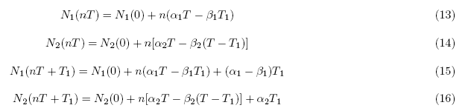
II. One-Way to One-Way Crossroads
In sharp contrast to the State I, in this state which is characterized by the equation (11) and referred to as the state II, the values of N₁ and N₂ are functions of the cycle number. This is easily seen by the following relations:
The above relations show that queues’ lengths grow linearly with time and a complete passing of a queue in one cycle is not possible.

Slide 14

II. One-Way to One-Way Crossroads
The sub-waiting times are as follows:
We now minimize the TWT with respect to T₁ which leads to the following equation:
the consistency of this solution with stability conditions (11) yields the following constraints:

Slide 15

II. One-Way to One-Way Crossroads
Next we consider the situation (state III) where in the first cycle of the traffic light, one has N₁(T₁) = 0 but N₂(0) > 0.
The conditions for a stable pattern are:
The above stability conditions ensures the following relations:
In the large cycle-number limit, minimizing of the TWT leads to the value

Slide 16

II. One-Way to One-Way Crossroads
The above solution is inconsistent with the stability conditions, and hence, is not acceptable as an optimum signalization of traffic light.
In the region determined by the stability conditions (21), the TWT is positive definite and therefore its minimum coincides with the upper limit of the inequalities (21).
Therefore one finds:
A similar argument applies to the final state ( state IV ) which is characterized by N₁(nT +T₁) > 0 and N₂(nT ) = 0

Slide 17
III. ONE-WAY TO TWO-WAY CROSSROADS
Eight different possibilities are identified due to the traffic conditions (two possibilities for each movement direction).
N
Cycle: T
Begin: S-N green
0 ~ T₁ ~ T₂ ~ T₃
α₂
β₁
α₃
β₃
W
E
β₂
g
g
g
α₁
S

Slide 18
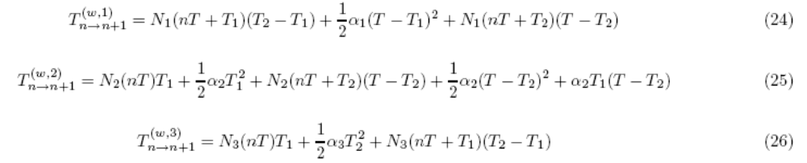
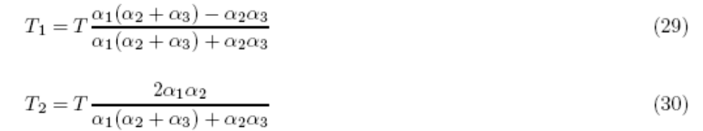
III. ONE-WAY TO TWO-WAY CROSSROADS
Now we write the explicit expression for the TWT during the n→n + 1cycle.

Slide 19
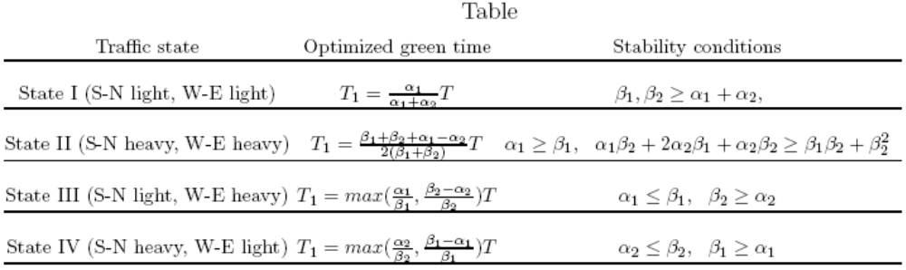
IV. SUMMARY
In the following table, we have summarized our theoretical optimized green times including stability conditions in four different traffic states of the one-way to one-way crossroads.

